Slide 1

WSO2 API Manager 4.2.0 Developer Advanced
Debugging and Error Handling
WSO2 Training

Slide 2
API Manager Components and Features

Slide 3
WSO2 API-M Components
APIs
org.wso2.carbon.apimgt.api
Defines Model Classes, interfaces, DTOs used by other APIM components
Core Implementation
org.wso2.carbon.apimgt.impl
Implementation code used for API Developer Portal, Publisher, admin-portal operations.
Populate configurations (RXTs, registry config files)
Listeners (Tenant Loading, User permission population)
DAO Layer

Slide 4
WSO2 API-M Components
Gateway
org.wso2.carbon.apimgt.gateway
API Handler implementation
Key Validator Services
org.wso2.carbon.apimgt.keymgt
Key generation, validation services
Util Services
Key Validator Client
org.wso2.carbon.apimgt.keymgt.client
Key validator service client implementations
Used by Developer Portal and Publisher
API Usage Publisher
org.wso2.carbon.apimgt.usage.publisher
Publishes events to the configured data receiver

Slide 5
WSO2 API-M Service Stubs
Service stubs are auto generated axis2 stubs for web services
Security
Org.wso2.carbon.apimgt.handlers.security.stub
Generated stub for APIAuthenticationService which invalidates keys/caches
Key Management
org.wso2.carbon.apimgt.keymgt.stub
Generated stub for APIKeyMgtProviderService (Key mgt service for API publisher) and APIKeyMgtSubscriberService (Key mgt service for Developer Portal)

Slide 6
WSO2 API-M Features
org.wso2.carbon.apimgt.core.feature
All the APIM components except gateway + dependent components + stubs
org.wso2.carbon.apimgt.gateway.feature
Gateway components and impl component + stubs
org.wso2.carbon.apimgt.publisher.feature
Publisher React application
API and Impl components
org.wso2.carbon.apimgt.store.feature
Developer Portal React application
API, Impl, Key mgt Client components + Stubs components
org.wso2.carbon.apimgt.feature
Composite APIM feature with above 4 features

Slide 7
Debugging Runtime Issues via Logging

Slide 8
Setting up Logging
A properly configured logging system is vital for identifying errors, security threats, and usage patterns.
WSO2 API Manager uses various types of logs to track real time internal and external activities.
Separate log files are created for each of those log types in the <APIM_HOME>/repository/logs directory.

Slide 9
Carbon Logs
WSO2 API Manager is shipped with log4j2 logging capabilities which generate logs for administrative and server-side activities.
By default, carbon logs are persisted in wso2carbon.log which is located in <APIM_HOME>/repository/logs directory.
You can configure the details that are captured in this log file by configuring the <APIM_HOME>/repository/conf/log4j2.properties.
The default values for carbon logs can be changed by manually updating log4j2.properties file.
Carbon Logs

Slide 10
Default configuration for carbon logs
appender.CARBON_LOGFILE.type = RollingFile
appender.CARBON_LOGFILE.name = CARBON_LOGFILE
appender.CARBON_LOGFILE.fileName = ${sys:carbon.home}/repository/logs/wso2carbon.log
appender.CARBON_LOGFILE.filePattern = ${sys:carbon.home}/repository/logs/wso2carbon-%d{MM-dd-yyyy}.log
appender.CARBON_LOGFILE.layout.type = PatternLayout
appender.CARBON_LOGFILE.layout.pattern =
TID: [%tenantId] [%appName] [%d] %5p {%c} - %m%ex%n
appender.CARBON_LOGFILE.policies.type = Policies
appender.CARBON_LOGFILE.policies.time.type = TimeBasedTriggeringPolicy
appender.CARBON_LOGFILE.policies.time.interval = 1
appender.CARBON_LOGFILE.policies.time.modulate = true
appender.CARBON_LOGFILE.policies.size.type = SizeBasedTriggeringPolicy
appender.CARBON_LOGFILE.policies.size.size=10MB
appender.CARBON_LOGFILE.strategy.type = DefaultRolloverStrategy
appender.CARBON_LOGFILE.strategy.max = 20
appender.CARBON_LOGFILE.filter.threshold.type = ThresholdFilter
appender.CARBON_LOGFILE.filter.threshold.level = DEBUG
appenders = CARBON_LOGFILE, CARBON_CONSOLE, AUDIT_LOGFILE, ATOMIKOS_LOGFILE, CARBON_TRACE_LOGFILE, CARBON_MEMORY,
DELETE_EVENT_LOGFILE, TRANSACTION_LOGFILE
```

Slide 11
Enable Logs for a Component
Open APIM_HOME>/repository/conf/log4j2.properties file.
Add a new logger specifying the component name that you need to enable logs and the log level as shown below.
logger.<Logger_Name>.name = <Component_name>
logger.<Logger_Name>.level = <Log_level>
Append the newly added logger name to loggers configuration, which is a comma separated list of all active loggers.
loggers = <Logger_Name>, trace-messages, org-apache-coyote,com-hazelcast
Enable Logs for a Component

Slide 12
Setting the Log Levels
The log level can be set specifically for each appender in the log4j2.properties file by setting the threshold value.
If a log level is not specifically given for an appender as explained below, the root log level (INFO) will apply to all appenders by default.
For example, shown below is how the log level is set to DEBUG for the CARBON_LOGFILE appender:
appender.CARBON_LOGFILE.filter.threshold.level = DEBUG
Setting the Log Levels

Slide 13
Gateway Wire logs
Gateway wire logs can be configured to monitor the HTTP message flow through the API Gateway.
In order to read the wire logs, you must first identify the message direction.
In a single roundtrip of an API request/response, you can observe the following message flows via the wire log.
Incoming request to API Gateway from API client (>>).
Outgoing request from API Gateway to actual backend (<<)
Incoming response from actual backend to API Gateway (>>)
Outgoing response from API Gateway to API client (<<)
Gateway Wire Logs

Slide 14
Enable Gateway Wire logs
Open APIM_HOME>/repository/conf/log4j2.properties file.
You will be able to find synapse-wire logger, which is already defined in the default log4j2.properties file.
logger.synapse-wire.name = org.apache.synapse.transport.http.wire
logger.synapse-wire.level = DEBUG
The synapse-headers logger can be used to log request and response headers only.
logger.synapse-headers.name = org.apache.synapse.transport.http.headers
logger.synapse-headers.level = DEBUG
Append the synapse-wire logger name to loggers configuration, which is a comma separated list of all active loggers.
loggers = synapse-wire, trace-messages, org-apache-coyote,com-hazelcast
If you want to activate the wire logs only for message headers, you can activate synapse-headers logger.
loggers = synapse-headers, trace-messages, org-apache-coyote,com-hazelcast
Enable Gateway Wire Logs

Slide 15
HTTP Access Logs
HTTP access logs help you monitor your application's usage with information such as the person who accesses it, how many hits it received, what the errors are, etc.
In API Manager, access logs can be configured for both servlet transport and PassThrough or NIO transports in API Gateway.
Configuring Access Logs for the HTTP Servlet Transport
In WSO2 API Manager, the access logs can be generated for HTTP servlet transport which works on 9443/9763 default ports.
HTTP servlet transport access logs are useful for analysing operational/admin-level access details.
Configuring Access Logs for PassThrough or NIO Transports in API Gateway
By default, access logs related to service/API invocation are disabled for performance reasons.
You should enable these access logs only for troubleshooting errors.
HTTP Access Logs

Slide 16
Audit Logs
Auditing is a primary requirement when it comes to monitoring production servers.
Audit logs or audit trails contain a set of log entries that describe a sequence of actions that occurred over a period of time.
Audit logs allow you to trace all the actions of a single user, or for example, all the actions or changes introduced to a certain module in the system over a period of time.
By default, the audit logs that get created when running WSO2 API-M are stored in the audit.log file, which is located in the <API-M_HOME>/repository/logs directory.

Slide 17
Audit logs are enabled by default in WSO2 API Manager (WSO2 API-M) via the following configurations, which are in the <API-M-HOME>/repository/conf/log4j2.properties file.
appender.AUDIT_LOGFILE.type = RollingFile
appender.AUDIT_LOGFILE.name = AUDIT_LOGFILE
appender.AUDIT_LOGFILE.fileName = ${sys:carbon.home}/repository/logs/audit.log
appender.AUDIT_LOGFILE.filePattern = ${sys:carbon.home}/repository/logs/audit-%d{MM-dd-yyyy}.log
appender.AUDIT_LOGFILE.layout.type = PatternLayout
appender.AUDIT_LOGFILE.layout.pattern = TID: [%tenantId] [%d] %5p {%c} - %m%ex%n
appender.AUDIT_LOGFILE.policies.type = Policies
appender.AUDIT_LOGFILE.policies.time.type = TimeBasedTriggeringPolicy
appender.AUDIT_LOGFILE.policies.time.interval = 1
appender.AUDIT_LOGFILE.policies.time.modulate = true
appender.AUDIT_LOGFILE.policies.size.type = SizeBasedTriggeringPolicy
appender.AUDIT_LOGFILE.policies.size.size=10MB
appender.AUDIT_LOGFILE.strategy.type = DefaultRolloverStrategy
appender.AUDIT_LOGFILE.strategy.max = 20
appender.AUDIT_LOGFILE.filter.threshold.type = ThresholdFilter
appender.AUDIT_LOGFILE.filter.threshold.level = INFO
Configuring Audit Logs

Slide 18
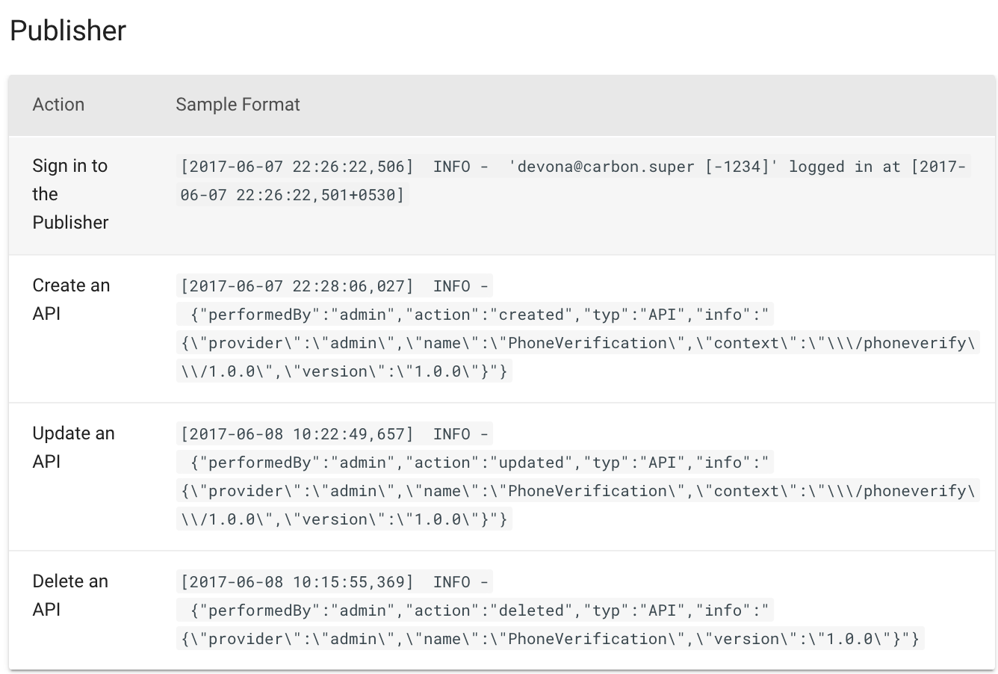

Slide 19
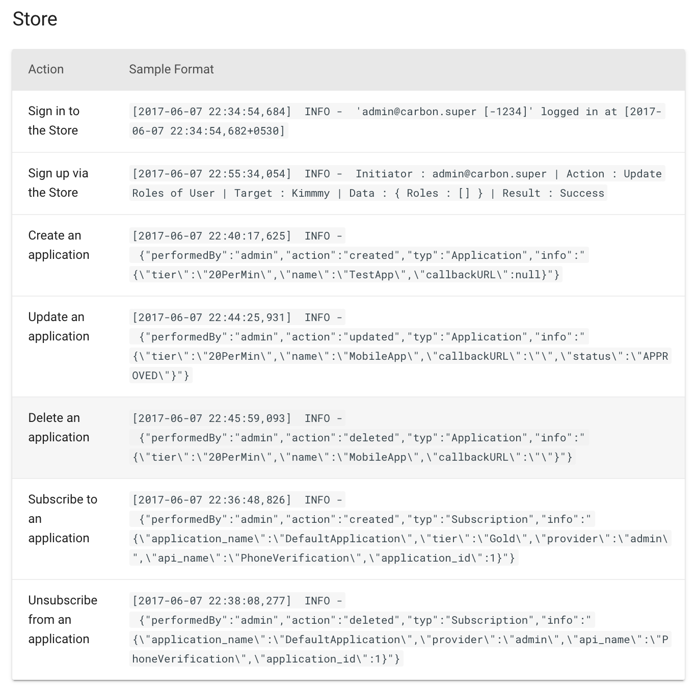
Developer Portal

Slide 20
API Logs
API Logs are used for tracking requests and responses going through the WSO2 API Gateway.
Since Correlation Logs cause lower performance on the API gateway, API Logs can be used to collect HTTP call logs without a considerable performance hit.
API Logs are disabled by default and can be enabled per API using Devops REST API or APICTL
There are 4 log levels that can be configured : OFF, BASIC, STANDARD, FULL
Properties logged in each log level are different and it is also possible to configure additional properties

Slide 21
Observability

Slide 22
Observability
WSO2 API-M facilitates observability by logging the following important points of the system with the time taken to achieve them. Refer Observability document for more details
Method Calls
External Calls (HTTP/HTTPS)
Database Calls (JDBC and LDAP)
When observability is enabled in WSO2 API-M, a random correlation ID is generated within the WSO2 API-M for each transaction allowing you to correlate the latter three types of calls.
The requests and the responses that correspond to a specific API call will be logged under one correlation ID making it easier to analyze the information.
If required, you can provide a unique correlation ID by adding the activityid in the header to the request sent to WSO2 API-M.
To enable observability find the following system property in the product startup script (stored in the <API-M_HOME>/bin/ directory) and set it to true. By default, this is set to false.
-DenableCorrelationLogs=true
Can enable without restarting the server from 4.2.0 onwards. See this

Slide 23
Method Log Calls
When correlation logging is enabled, the API Manager logs the time taken to execute certain important methods of the following modules.
org.wso2.carbon.apimgt.gateway
org.wso2.carbon.apimgt.keymgt
org.wso2.carbon.apimgt.impl
In API Manager by default, the important methods are marked with the @MethodStats annotation, and this annotation can be found at both the method level and the class level.
All the methods of the respective class are included for logging for the classes that have the latter mentioned annotation. The format of a method log entry is as follows:
timestamp | correlationID | threadName | duration | callType | className | methodName | methodArguments
Method Log Calls

Slide 24
External Call Log
You can enable correlation logs in WSO2 API-M to track the complete round trip of an individual HTTP message.
You can monitor individual HTTP requests from the point that a message is received by WSO2 API-M until the corresponding response message is sent back to the original message sender (client → API-M → back-end → API-M → client).
You can use the correlation log file to monitor and analyze external calls in detail.
The following are the two types of external call logs that can be tracked via observability in WSO2 API-M.
External call logs with API-M specific information
External call logs with transport level information

Slide 25
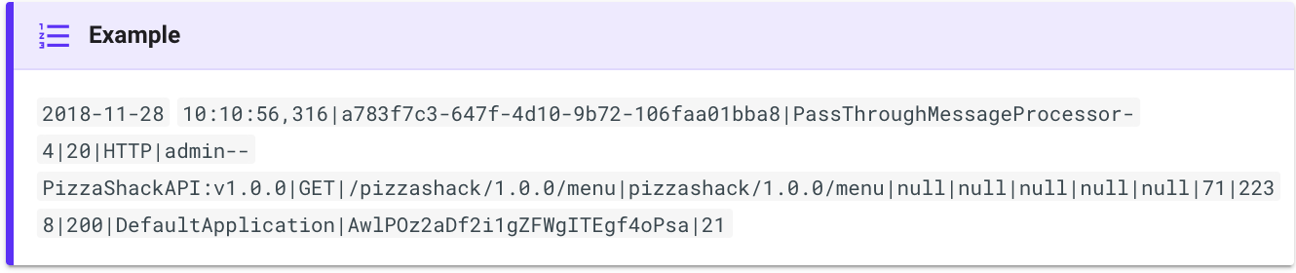
External Call Logs with APIM Specific Information
All external calls done by the API Manager are logged via this category.
This does not include DB calls.
This is done via a Synapse Global Handler that logs the important information of the external calls.
The format for a Synapse global handler level external call log entry is as follows:
timestamp | correlationID | threadName | duration(BE latency) | callType | apiName | apiMethod | apiContext | apiResourcePath | authHeader | orgIdHeader | SrcIdHeader | applIdHeader | uuIdHeader | requestSize | responseSize | apiResponseStatusCode | applicationName | consumerKey | responseTime
External Logs with API-M Specific Information

Slide 26
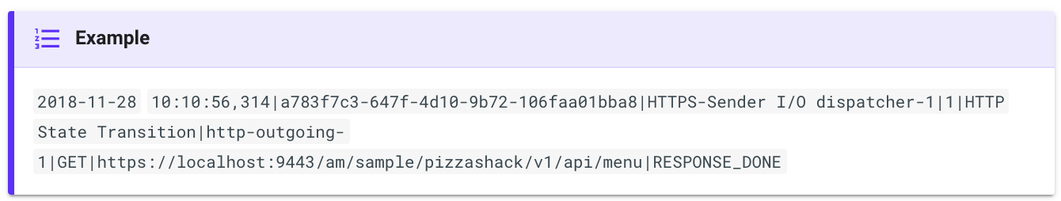
External Call Logs with Transport Level Information
In contrast to the information provided by the Synapse global handler level, the passthrough transport level gives certain additional data such as, the Synapse internal state of the request.
The format for a Synapse passthrough transport level external call log entry is as follows:
timestamp|correlationID|threadName|duration|callType|connectionName|methodType|connectionURL|httpState
External Call Logs with Transport Level Information

Slide 27
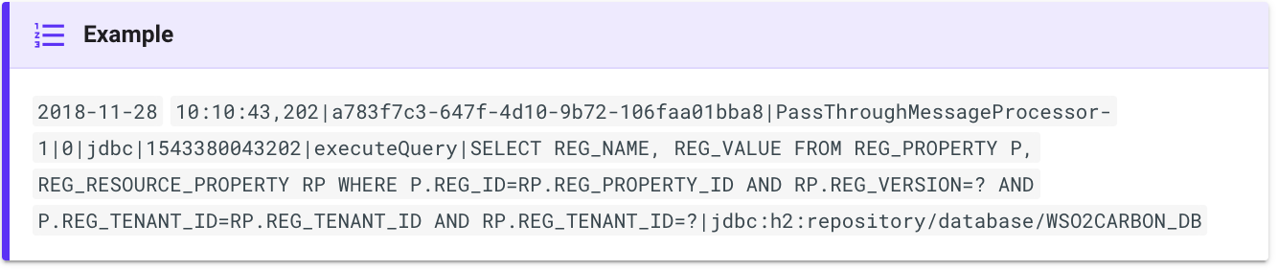
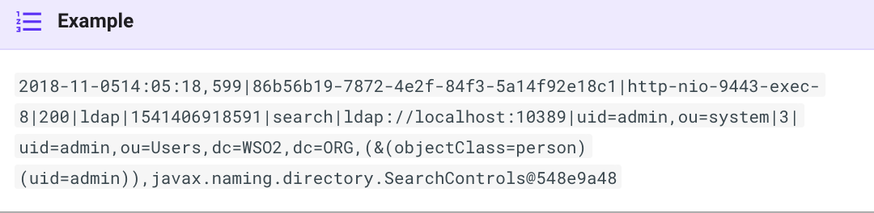
Database Call Logs
Database call logging will help to track down any latencies caused by a database call in an instance.
JDBC call logs
Format
timestamp | correlationID | threadID | duration | callType | startTime | methodName | query | connectionUrl
LDAP call logs
Format
timestamp | correlationID | threadID | duration | callType | startTime | methodName | providerUrl | principal | argsLengeth | args
JDBC Call Logs
LDAP Call Logs

Slide 28
Using the Correlation Logs to Track a Specific Request
Enable observability with WSO2 API-M and start the WSO2 API-M server.
Use the following command to invoke the API.
curl -k -H "Authorization :Bearer <access-token>" "activityid:<example-correlation-ID>" --data "<payload>" <api_url>
Open a terminal and navigate to the <API-M_HOME>/repository/logs directory where the correlation.log file is saved.
Isolate the logs that are correlated.
Replace <correlation_ID> with the <example-correlation-ID> given above.
cat correlation.log | grep "<correlation_ID>"
Using Correlation Logs to Track Requests

Slide 29
Narrowing Down a Bottleneck using Observability
Scenario: A request sent to the API Manager takes a lot of time to respond back
This can happen due to several reasons
Due to a programming error
Due to a backend service call taking time
Due to a database/ ldap call taking time
You can list the times consumed by the code level, using the following command. This will help you to pinpoint method level latencies.
cat correlation.log | grep “|METHOD|” | cut -d “|” -f4 | sort -n
This will give the time consumed by each method in ascending order. If a method with a high time consumption is identified, then take the 5 most time consuming service and database calls, with the same correlation ID of the method logs, and find out the unusually time consuming call.
cat correlation.log | grep “correlationID” | grep “|HTTP” | cut -d “|” -f4 | sort -n
cat correlation.log | grep “correlationID” | grep “|DB_CALL|” | cut -d “|” -f4 | sort -n
cat correlation.log | grep “correlationID” | grep “|ldap|” | cut -d “|” -f4 | sort -n
Narrowing Down a Bottleneck using Observability

Slide 30
Logging All Methods
Currently, when using method logging, it only logs special methods that are suspected to give latencies, because logging all methods can pose performance issues.
There can be instances where you may need to log other methods too.
In order to configure the logging of all methods, add the following configuration as a system property to the APIM startup script.
This will log all methods executed in the given package.
-DlogAllMethods=<package_name>
Logging All Methods

Slide 31
Blocking Threads
Blocking threads is needed because some threads keep on printing unnecessary jdbc logs continuously.
By blocking these unwanted threads from printing logs, it helps to reduce the cluttering of the logs.
In order to enable blocking of threads, add the following configuration as a system property to the the APIM startup script.
Format
-Dorg.wso2.CorrelationLogInterceptor.BlacklistedThreads=<threadName1>,<threadName2>
If the above configuration is not added, by default the MessageDeliveryTaskThreadPool thread will be blocked as it is found to print a considerable amount for messages for API-M instances.
Blocking of threads is not needed by default, as all unnecessary threads are already blocked.
Blocking Methods

Slide 32
Error Handling

Slide 33
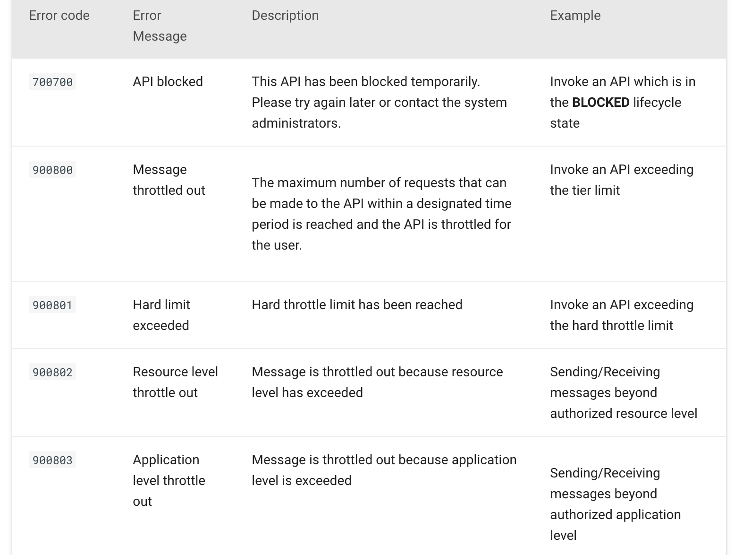
API Handlers - Error Codes
API Handler Error Codes

Slide 34
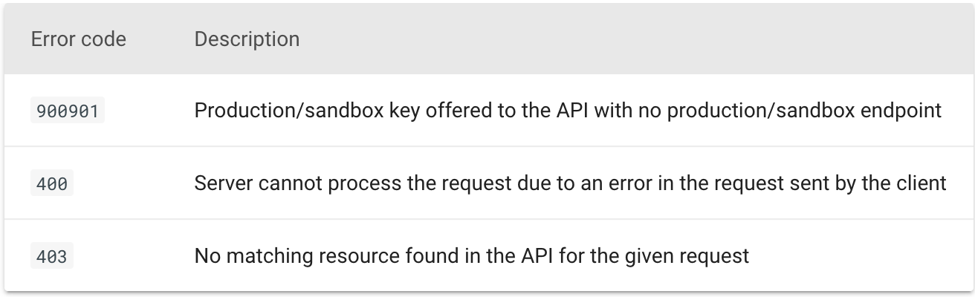
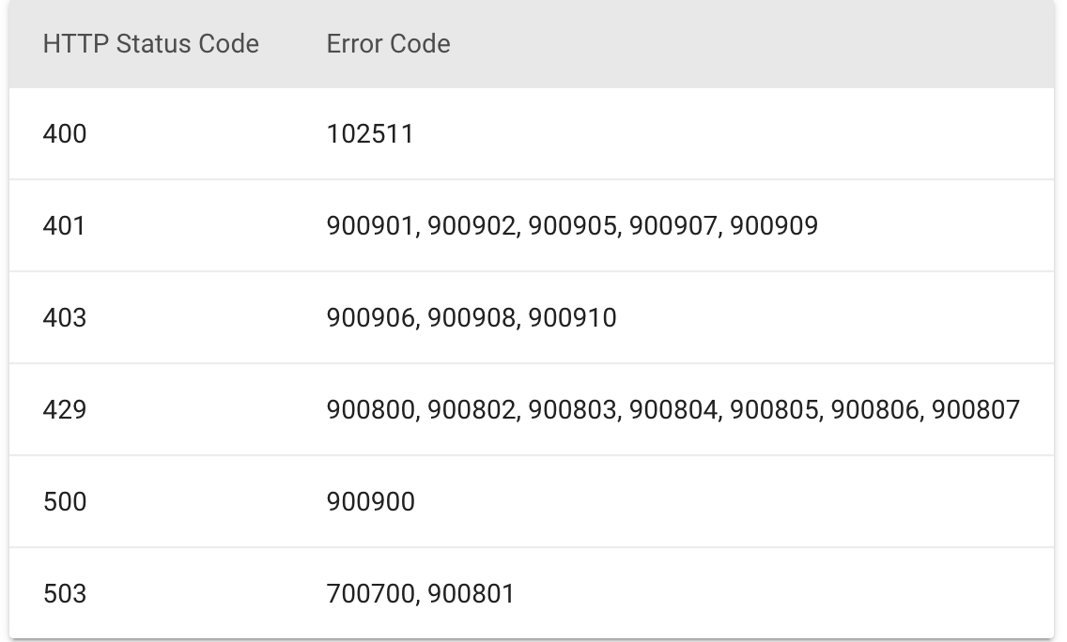
Sequences - Error Codes
Sequences Error Codes

Slide 35
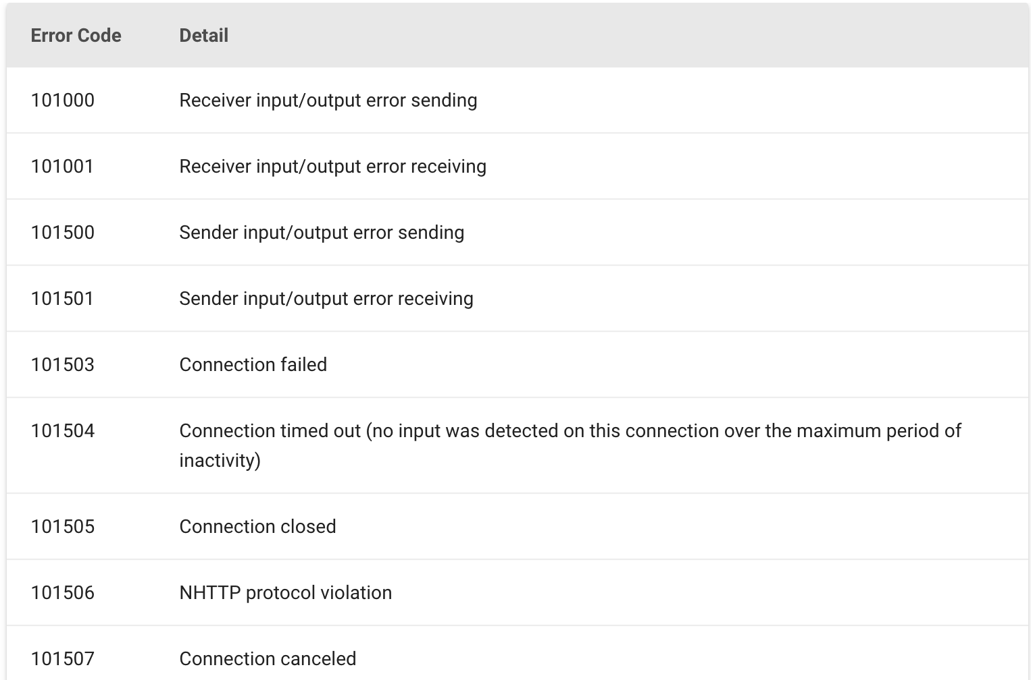
Transport - Error Codes
Transport Error Codes

Slide 36
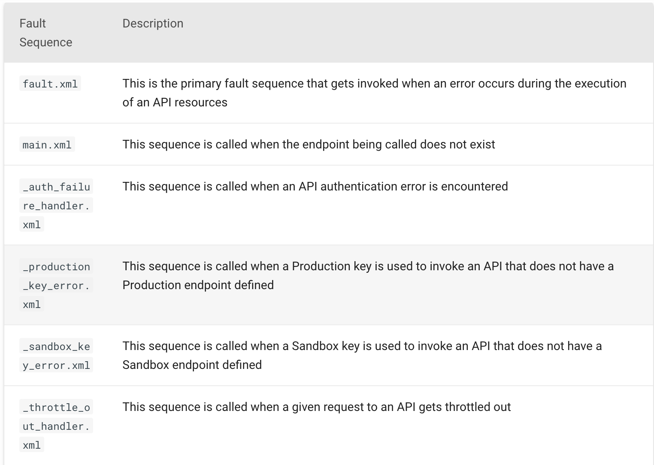
WSO2 API Manager has the following default fault sequences located in <API-M_HOME> /repository/deployment/server/synapse-configs/default/sequences directory.
Error Handling

Slide 37

Let’s try it out!
Enabling and Observing Gateway Wirelogs

